Slide 1
Laundry Service Booking and Order Tracking System
A low-code application built with Zoho Creator
NITHISH RAJ L | 240701366
CB23F35 – Low-Code Application Development using Zoho Creator
Rajalakshmi Engineering College | November 2026
Notes:
Introduce yourself and the project: a laundry order booking and tracking app built on Zoho Creator.

Slide 2
Problem and Objectives
The problem
Objectives
Orders recorded in notebooks and memory
Charges and discounts worked out by hand
Order status known only by phone or verbally
Totals and pending work compiled manually
Linked Customer and Order forms
Auto-calculate total, discount and final amount
Validate weight and dates before saving
Track Received → Washing → Ready → Delivered
Reports and dashboard for the owner
Notes:
Explain how a small laundry works today and what the application fixes.

Slide 3
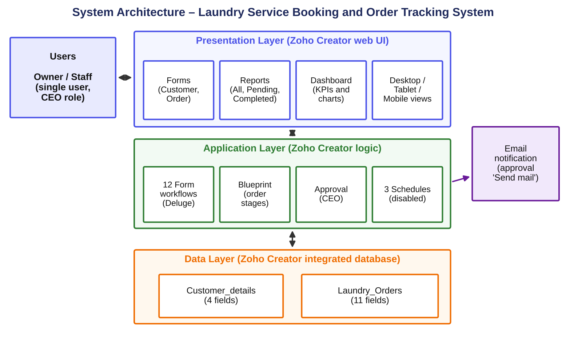
System Architecture
Presentation: forms, reports, dashboard
Logic: 12 form workflows (Deluge), blueprint, approval, schedules
Data: Zoho Creator database
Email through the approval ‘Send mail’ action
Notes:
Three layers: the Creator web interface, workflows and Deluge logic, and the integrated database.

Slide 4
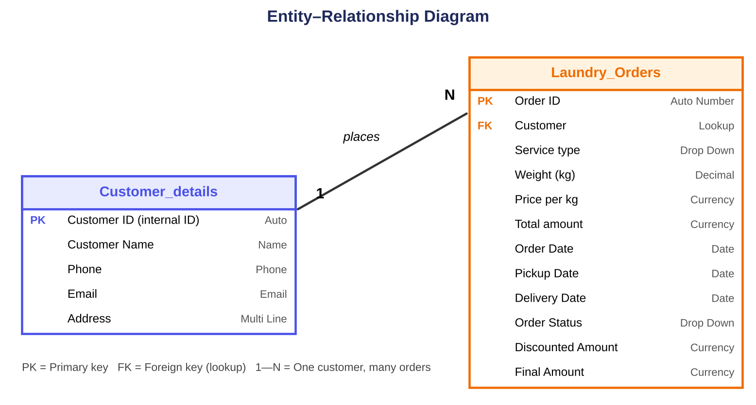
Data Model: 2 Linked Forms
Customer details: name, phone, email, address
Laundry Orders: 11 fields incl. customer lookup, service type, weight, price, dates, status, discount, final amount
One customer has many orders
10 distinct field types used
Notes:
One-to-many relationship implemented with a lookup field.

Slide 5
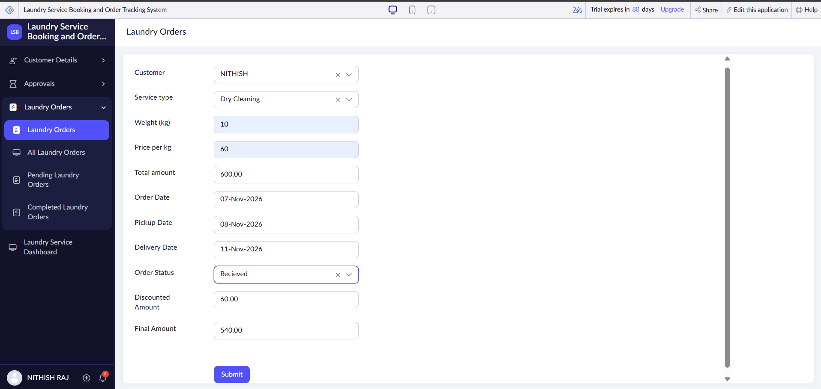
Booking an Order with Auto-Calculation
₹600
10 kg × ₹60 = total amount
₹60
10% discount when total ≥ ₹500
₹540
final amount payable
Notes:
Total, discount and final amount are filled by Deluge workflows as soon as weight and price are entered.

Slide 6
Deluge Scripting
Script | Trigger | What it does
DS-01 Calculate Total | User input of Weight | Weight × price per kg; 0 if a value is missing
DS-02 Apply Discount | User input of Total amount | 10% off when total ≥ ₹500; sets final amount
DS-03 Validate Weight | Form submission | Blocks weight ≤ 0 with a message
DS-04 Validate Dates | Form submission | Blocks delivery date earlier than pickup
DS-05 Confirmation Message | Successful submission | Fetches customer and builds the order message
Notes:
Five scripts are documented in full in Appendix C of the report.

Slide 7
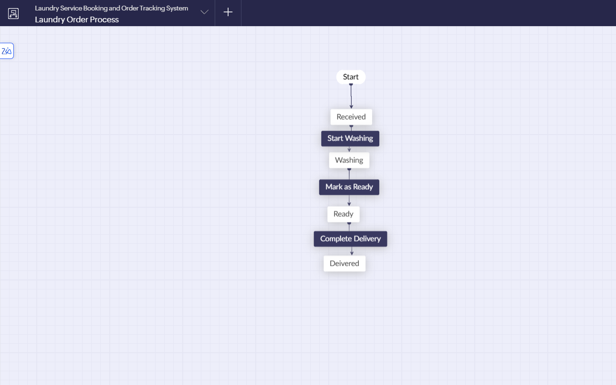
Workflows, Approval and Blueprint
12
3
form workflows
schedules
1
1
approval (CEO)
blueprint
Approval sends mail to the submitter on approve or reject. The three schedules are configured but disabled.
Notes:
The blueprint forces every order through Received, Washing, Ready and Delivered.

Slide 8
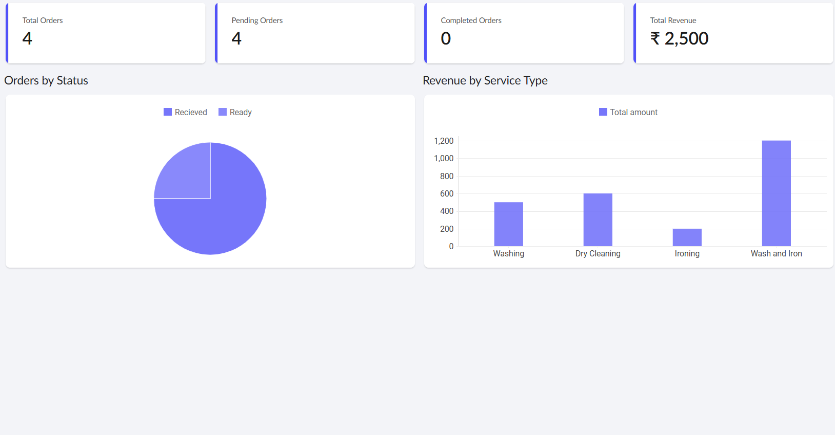
Reports and Dashboard
4 list reports: All Customers, All Orders, Pending, Completed
KPI cards: total, pending, completed orders and revenue
Charts: Orders by Status, Revenue by Service Type
Captured with 4 orders and ₹2,500 total
Notes:
Revenue is the sum of Total amount before discount.

Slide 9
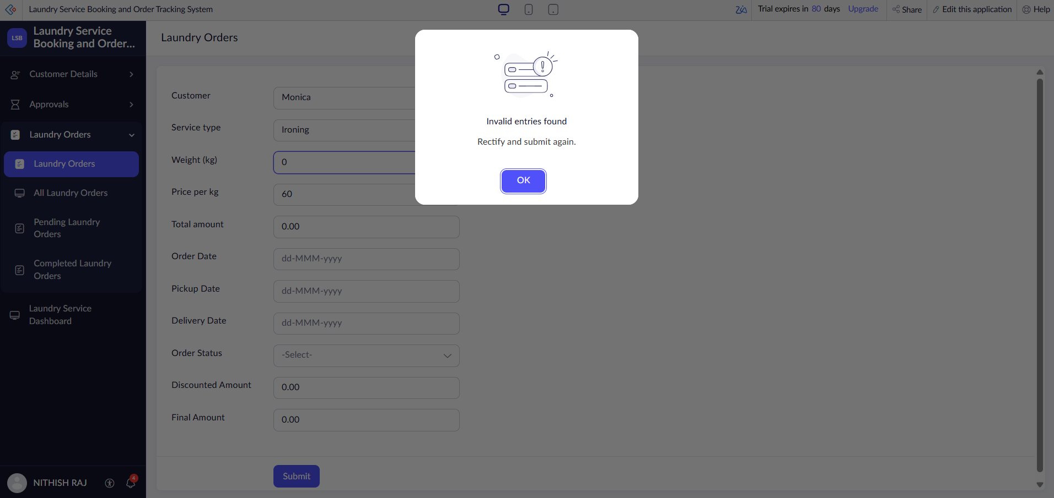
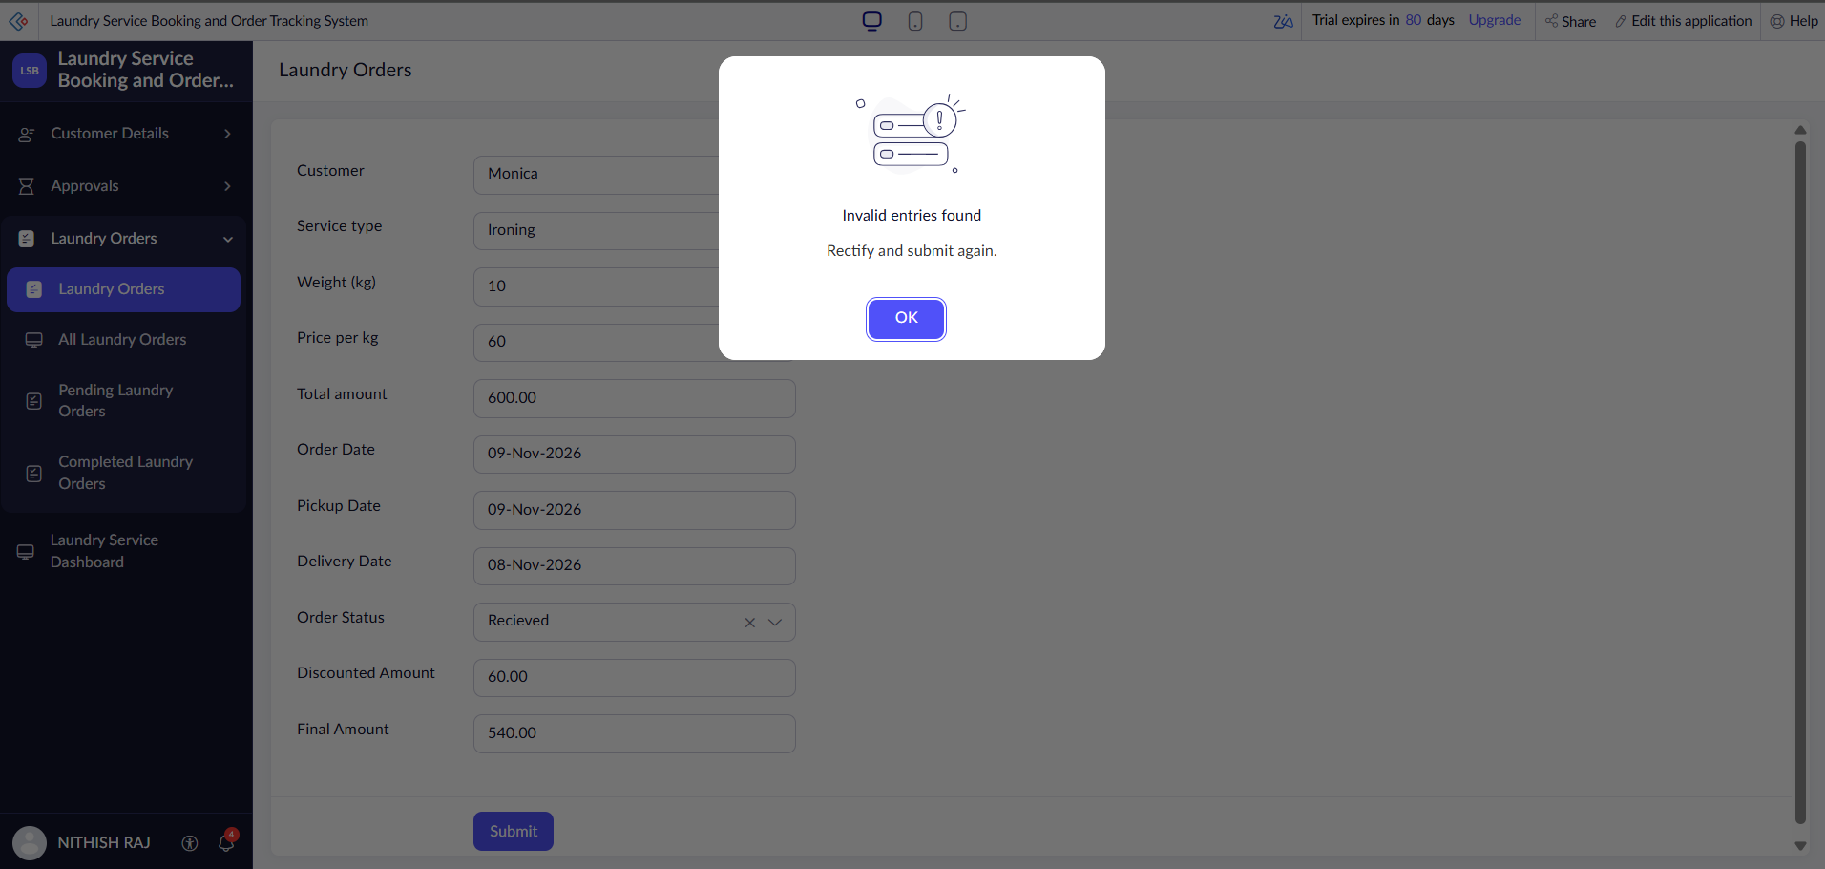
Testing: 10 of 10 Test Cases Passed
10 / 10
test cases passed
Customer registration and mandatory fields
Weight 0 and delivery-before-pickup rejected
Total, discount and final amount correct
Blueprint, reports and dashboard verified
Weight 0 rejected
Date order rejected
Notes:
Both validation screens show the intended “Invalid entries found” behaviour.

Slide 10
Conclusion and Future Enhancements
Conclusion
Future enhancements
Complete order flow built on Zoho Creator
Little code: Deluge only for rules
Single-user prototype under the CEO role
Service price list and order items
Payment and feedback forms
Staff, delivery agent and customer roles
Online payment and customer notifications
Notes:
Thank the panel and invite questions.

